Slide 1
MICROSERVICE PROJECT
ShopEase
Online Product & Order Management System
A full-stack microservice architecture built with React · Spring Boot · MySQL
👥 10 Members
⚙️ 10 Microservices
🛠️ 3 Tech Stacks

Slide 2
Problem Statement & Proposed Solution
⚠️
Problem Statement
💡
Proposed Solution
🏬
Traditional shopping requires physical visits to stores
🌐
Online platform for buying and selling products easily
📦
Limited access to a wide range of products
🔍
Easy product browsing with category filters
📋
Difficulty managing orders and inventory manually
🛒
Secure order management with real-time tracking
🔒
No secure role-based system for buyers, sellers & admins
🛠️
Admin control over products, categories & users
📊
Lack of real-time order tracking for customers
🔐
JWT-secured login with roles: Customer, Seller, Admin

Slide 3
Meet the Team
Group of 10 · ShopEase Microservice Project
1
P. Yashwanth Krishna
2
S. Ramudu
Seller Order Mgmt · Frontend Seller & Admin UI
Seller Order Management Service
3
B. Akshaya
4
Indluru Anjali
Seller Product Management Service
Order Placement & Cart Service
5
S. Penchala Prasad
6
G. Gowthami
Order Placement & Cart · Frontend Customer UI
Product Catalog & Category Service
7
B. Naga Surya Reddy
8
G. Thanusha
Customer Order Tracking Service
Seller Product Mgmt · Frontend Auth & Shared
9
S. Sivakumar
10
Thammisetty Jeevan
Admin Category & User Management Service
User Authentication & Security Service

Slide 4
User Flow
Customer · Seller · Admin · MySQL Database
🔐 Login / Register
👤 Customer
🏪 Seller
🛠️ Admin
Browse Products
& Filter Category
List / Update
Products
Manage
Categories
Place Order
& Cart
View Incoming
Orders
View All
Users
Track Order
Status
Update Status
PENDING→DELIVERED
Delete / Oversee
Accounts
🗄️ MySQL Database
Users · Products · Categories · Orders · OrderItems

Slide 5
Objectives & Technologies Used
🎯
Objectives of the Project
⚙️
Technologies Used
1
Develop a user-friendly e-commerce platform
Frontend
React
2
Provide secure login and registration
Backend
Java · Spring Boot
3
Enable product browsing and ordering
Database
MySQL
4
Implement admin management features
Tools
Postman · VS Code · MySQL Workbench
5
Build scalable microservice-based architecture

Slide 6
Key Features
What ShopEase offers across all roles
🔐
Secure Authentication
🗂️
Product Catalog
🛒
Order Management
JWT-based login & registration for Customer, Seller, and Admin roles
Browse & search products with category filters and stock availability
Place orders with cart-style inputs, stock validation & total computation
📦
Order Tracking
🏪
Seller Dashboard
🛠️
Admin Control Panel
Customers track orders in real time: PENDING → PROCESSING → SHIPPED → DELIVERED
Sellers list products, manage inventory and fulfil incoming orders
Admins manage product categories and oversee all registered user accounts

Slide 7
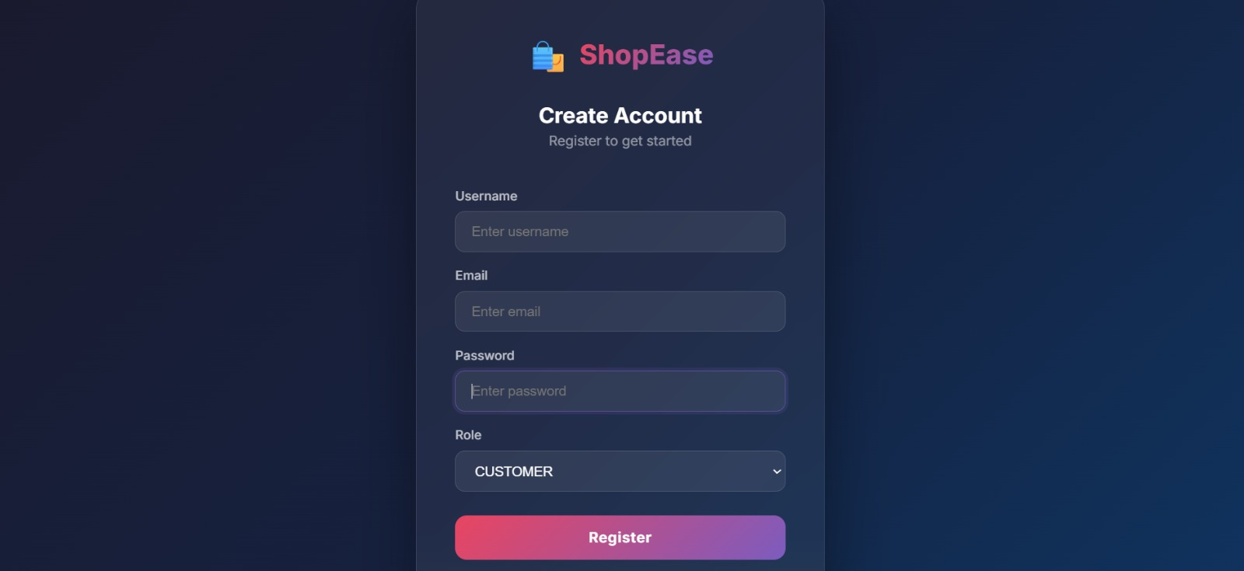
Login & Register Page

Slide 8
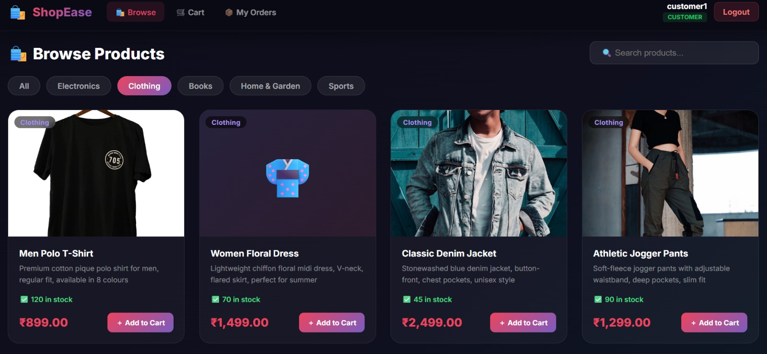
Customer Dashboard — Browse Products
What customers see after login

Slide 9
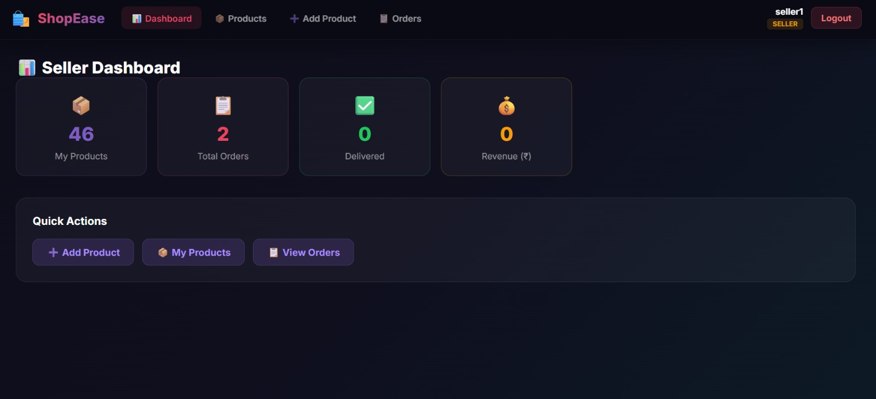
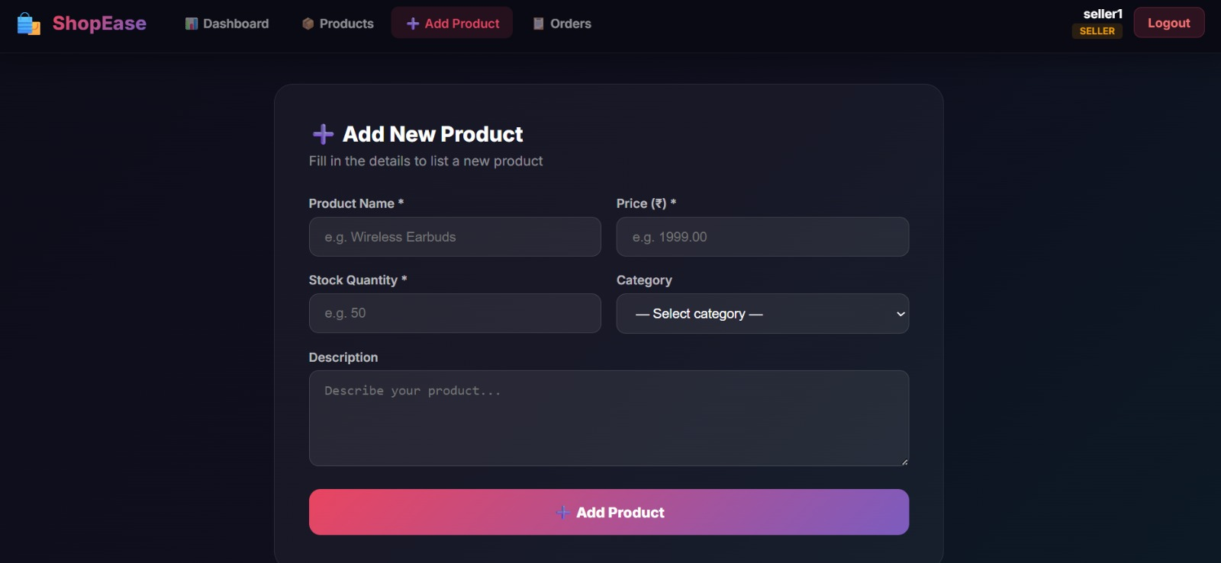
Seller Dashboard
📊 Dashboard Overview
➕ Add New Product

Slide 10
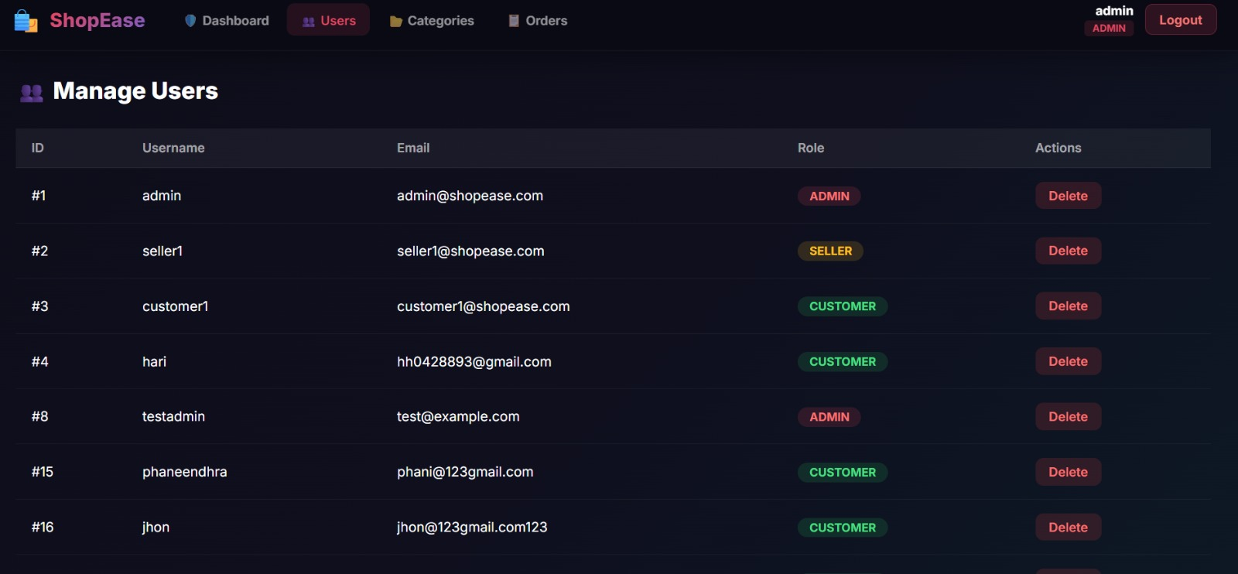
Admin Dashboard — Manage Users
Admin can view, manage and delete all registered users

Slide 11
Challenges & Future Enhancements
⚡
Challenges Faced
🚀
Future Enhancements
🔗
Coordinating 10 microservices across team members without conflicts
💳
Integrate online payment gateway (Razorpay / Stripe)
🔐
Implementing JWT security and role-based access across all endpoints
📱
Build a mobile app using React Native for iOS & Android
🗄️
Managing shared database entities across independent services
⭐
Add product ratings, reviews and wishlist features
🔄
Keeping stock levels consistent during concurrent order placements
📧
Email and SMS notifications for order status updates
🖥️
Connecting React frontend with multiple Spring Boot backend services
📊
Advanced analytics dashboard for sellers and admins

Slide 12
Conclusion
ShopEase successfully demonstrates a real-world microservice architecture by combining React, Spring Boot, and MySQL into a fully functional e-commerce platform. The project enabled 10 team members to collaborate on 10 independent services — each owning a dedicated responsibility.
✅
🤝
📚
All Goals Achieved
Team Collaboration
Learning Outcome
Secure auth, product catalog, order management, seller & admin dashboards all delivered
10 members built 10 microservices following a structured build order with clean API contracts
Gained hands-on experience in full-stack development, REST APIs, JWT security & microservices

Slide 13
🙏
Thank You!
We hope ShopEase gave you a clear picture of microservice-based full-stack development.
ShopEase · Online Product & Order Management System
React
Spring Boot
MySQL
Group of 10

